Slide 1
Analysis and Prediction of Parkinson’s Disease Status: A Machine Learning Approach
Erin S. King, Jacquelyn Aguilar Martinez, Safa Zia, Sara Butt, Lakshmi Kanikkannan
PH 1976: Fundamentals of Data Analytics and Predictions
Notes:
Hi everyone! I hope everyone is doing well. Our group, consisting of <other 4 people, depending on who is presenting> and me, are here to present our analysis to you all. Next slide please.

Slide 2
Introduction
01
Notes:
Starting with a quick introduction, next slide please!

Slide 3
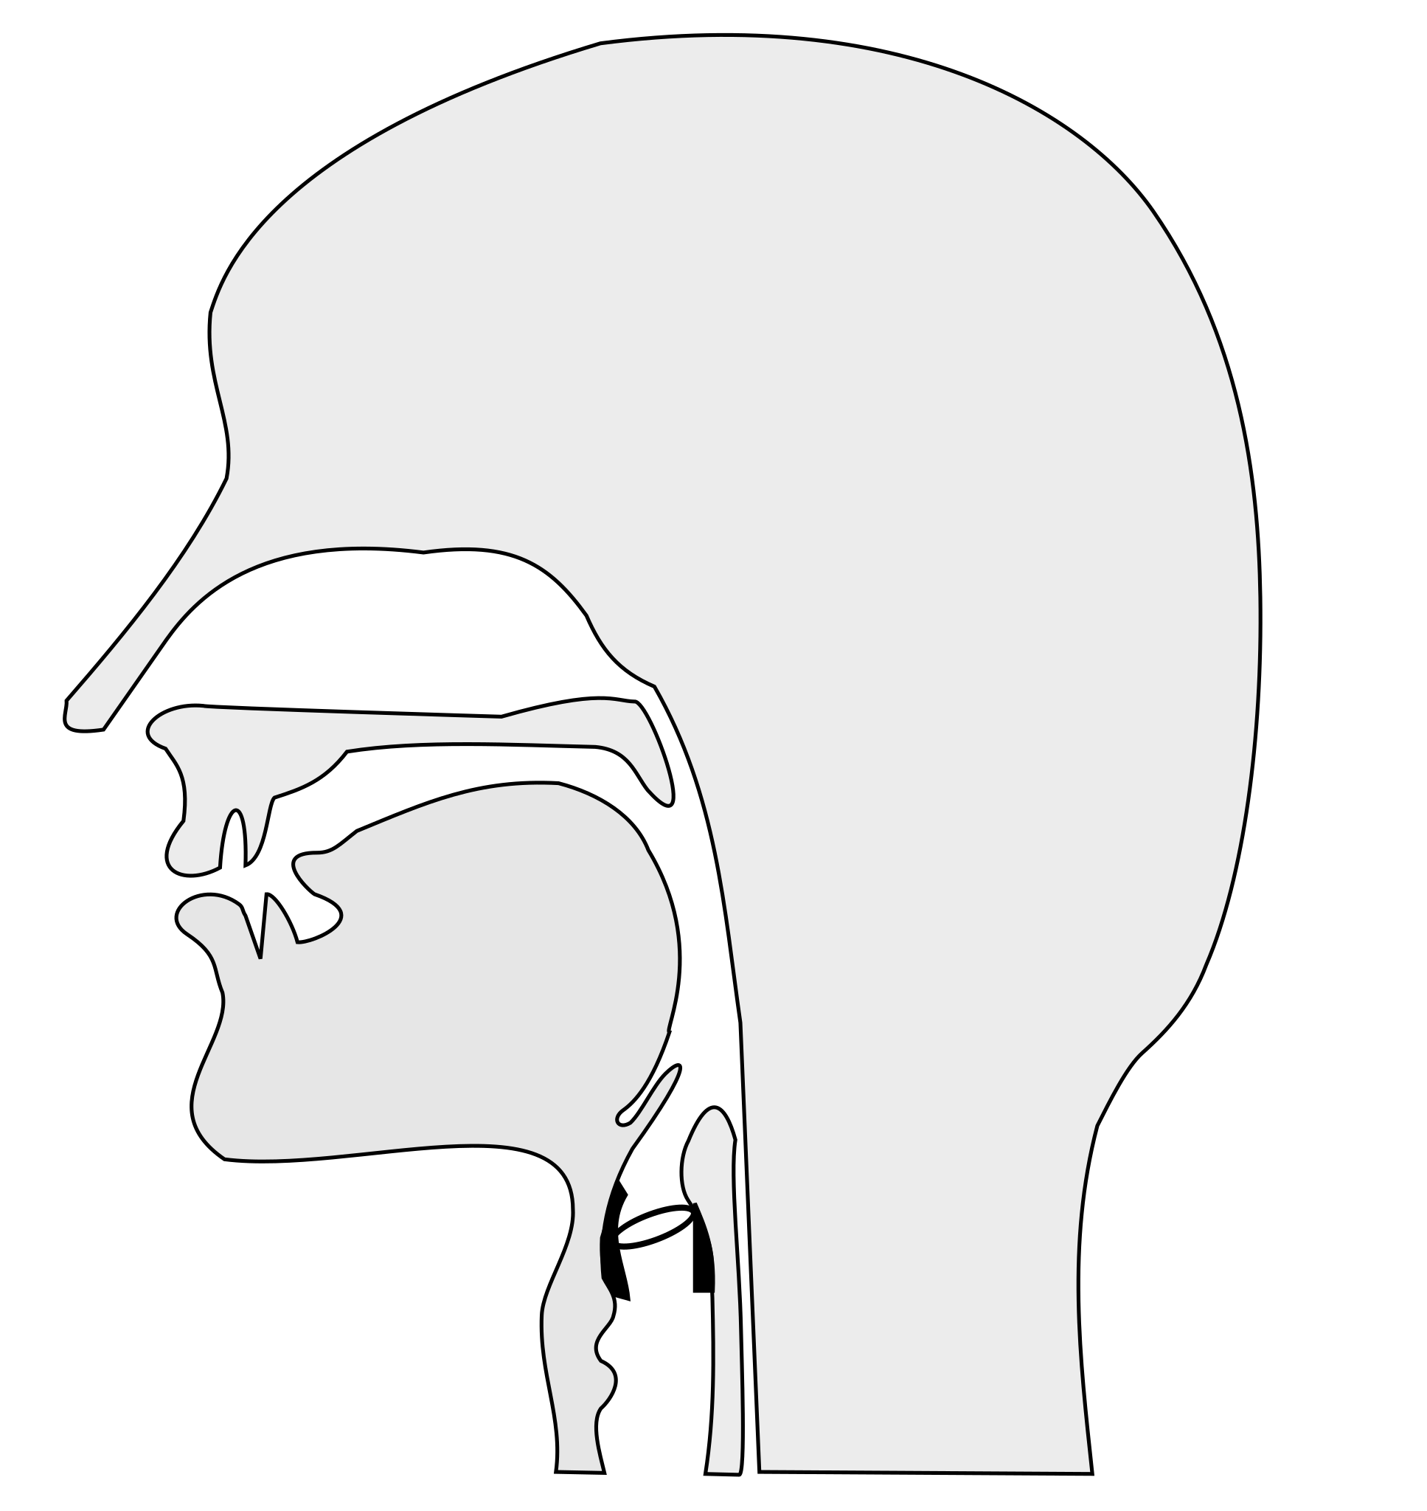
PARKINSON’S DISEASE
Parkinson’s disease (PD) is a brain disorder that can affect movement, balance, coordination, and speech.
Previous studies have used speech recordings and various algorithms to classify PD with high accuracy, but with limitations such as higher bias and low statistical power.
Vocal abnormalities have been identified as early indicators of PD and are prevalent in about 70-90% of those affected.
Notes:
Parkinson’s disease is a brain disorder usually seen in aging populations that mainly affects dopamine-delivering neurons. While symptoms like tremors and stiffness are the most common symptoms, vocal changes are also often seen in those affected. The vocal cords and surrounding muscle tissues cause irregular motions or vibrations as they change with the disease. These vocal changes are one of the first indications of Parkinson's, and make their early detection and treatment paramount for improving patient outcomes.
In this work, we methodically analyze and model these vocal cord features to predict Parkinson's disease status. Existing studies have used a variety of algorithms to make these predictions, including: k-means clustering, regression, neural networks, and decision trees. Some of these studies have demonstrated high prediction accuracy, but also some potential limitations. High bias has been cited as a potential area of concern, as well as diminished statistical power due to the use of small datasets. However, early detection and screening remain important within the field, and are a prime area for machine learning research. Next slide please.

Slide 4
OUR OBJECTIVE
Examine potential machine learning approaches for suitability and accuracy, using various vocal feature subsets to test the dataset collected by Sakar et al. and predict Parkinson’s disease status.
Notes:
Our aim is to compare machine learning algorithms, identifying those that have the potential to classify Parkinson's disease status most effectively based on the speech recording data provided. Next slide please.

Slide 5
Methods
02
Notes:
Coming now to the methods, next slide please!

Slide 6
Dataset and Feature Subsets
Seven feature subsets:
Baseline features
The dataset used for the analysis was collected by Sakar et al.
Dataset includes voice recordings of 252 subjects, including PD patients and healthy individuals. There are three voice samples for each subject and a myriad of predictors, identified by seven feature subsets.
We use the features to inform the machine learning model and perform predictions on the test set.
Intensity-based features
Bandwidth/formant features
Vocal fold features (VFF)
Mel Frequency Cepstral Coefficients (MFCC)
Wavelet transform-based features (WT)
Tunable Q-factor wavelet transform-based features (TQWT).
Notes:
This examination utilized data collected by Sakar et al., and consisted of 252 subjects. Both Parkinson's-diagnosed patients and healthy people were included. Three recordings were taken from each subject, for a total of 756 recordings. The following seven feature subsets were categorized from each recording: baseline features, intensity based features, bandwidth and formant features, vocal fold features, mel frequency cepstral coefficients, wavelet transform based features, and tunable q-factor wavelet transform based features. These subset features were examined using different machine learning algorithms, and were eventually used to inform an integrated machine learning model. Next slide please.

Slide 7
Data Partitioning, Standardization, and Feature Selection
The training data was split 90/10 to create ensemble model training (90%) and validation (10%) sets.
These sets were further divided into the determined feature subsets.
Standardization was applied to the training, validation, and test data sets.
For each feature, training mean and standard deviation were used to normalize the data, per a traditional Z-score method
Minimum redundancy methods with maximum relevance-based filter (mRMF) feature selection were used to determine the most important features of every feature subset.
Only the most relevant features amongst the subsets were used for analysis.
Notes:
The data were separated into training and test sets using a 90/10 split. We then divided the training data by each feature subset named above, and we standardized the training, validation, and test sets using the mean and standard deviation from the training set. This helps to ensure that no information leakage occurs when standardizing the data. When considering the question of feature selection, we opted to use minimum redundancy-maximum relavence based feature selection, due to its effective dimension reduction. This ensured that only the most significant features for each subset would be selected. We used the Boruta R package to do this, and used Random Forests to search for the most important features. Next slide please.

Slide 8
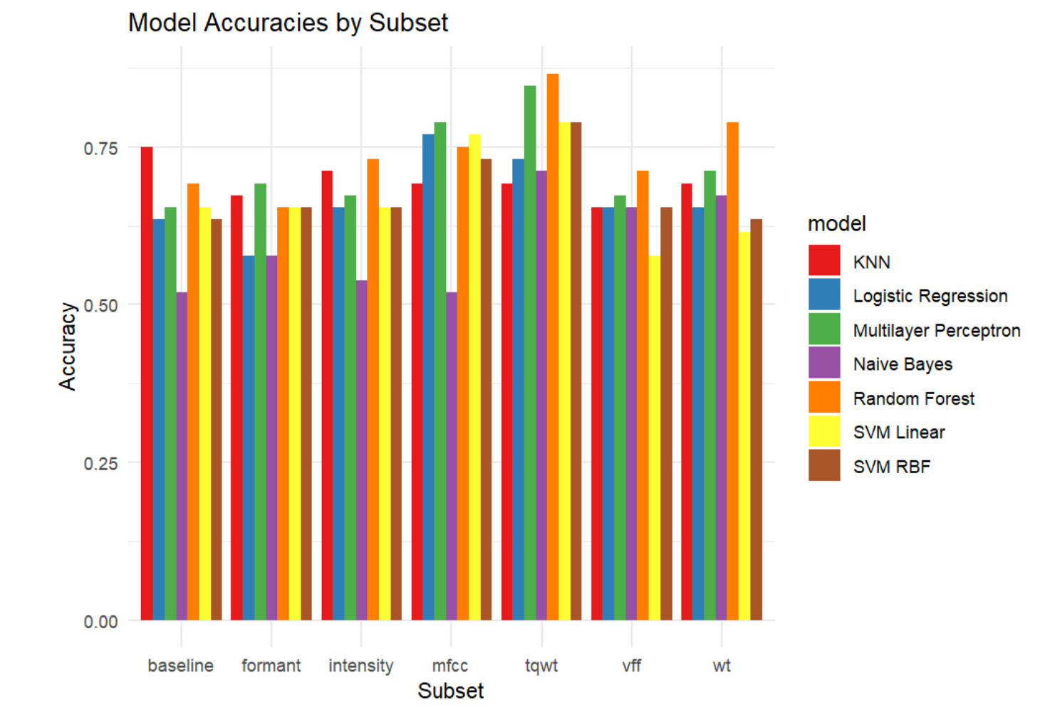
Predictive Algorithm Comparison
Baseline features: KNN with an accuracy of 0.75
Intensity-based features: Random Forest with an accuracy of 0.7307692
Bandwidth/formant features: Multilayer Perceptron with an accuracy of 0.6923077
Vocal fold features (VFF): Random Forest with an accuracy of 0.7115385
Mel Frequency Cepstral Coefficients (MFCC): Multilayer Perceptron with an accuracy of 0.7884615
Wavelet transform-based features (WT): Random Forest with an accuracy of 0.7884615
Tunable Q-factor wavelet transform-based features (TQWT): Random Forest with an accuracy of 0.8653846
Algorithms used for comparison included: Random Forests, Multilayer Perceptron, Logistic Regression, SVM w/ Linear Kernel, SVM w/ Radial Kernel, Naive Bayes, and k-Nearest Neighbors (k-NN).
Each feature subset was tested against the validation set.
Accuracy estimates were generated from the split 10% validation data used to compare the performance of each algorithm for each subset.
1
2
3
4
5
6
7
Notes:
At this time, each machine learning method was used to generate a predictive model for each of the sub-features. These predictive models were compared against the validation set, by subfeature, to determine the model's accuracy. For the final model, the method that produced the highest accuracy model for each sub-feature was selected.
Baseline subfeatures were best represented by K-NN at 75% accuracy. Intensity-based subfeatures were best represented by Random Forest at 73% accuracy. Bandwidth/formant subfeatures were best represented by Multilayer Perceptron at 69% accuracy. Vocal fold subfeatures were best represented by Random Forest at 71% accuracy. Mel frequency cepstral coefficients were best represented by Multilayer perceptron at 78% accuracy. Wavelet transform based features were best represented by Random Forest at 79% accuracy. Tunable Q-factor wavelet transform-based features were best represented by Random Forest at 87% accuracy.
Overall, Random Forest and Multilayer Perceptron were identified as the most effective for the final integrated model. This graph provides an overview of algorithm performance for each feature subset. Next slide please.

Slide 9
Results & Discussion
03
Notes:
Now we move onto the construction and results for the ensemble model, next slide please!

Slide 10
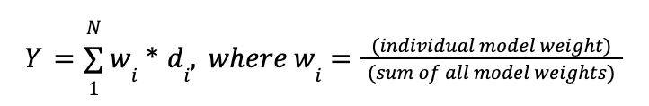
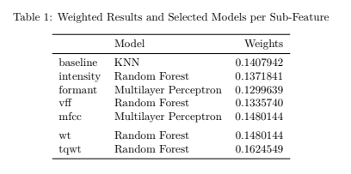
Ensemble Predictive Model
The best-performing algorithm for each sub-feature was used to develop the ensemble model Y.
A combination of weights and predictions is used to develop the ensemble model (Table 1).
The ensemble predictive model had a prediction accuracy of 0.7692, indicating that it can be a useful tool for early diagnosis and treatment of Parkinson’s disease.
Notes:
After determining the best algorithms for each sub-feature, an ensemble model consisting of seven parts was constructed. This ensemble model is based on the equation shown, and follows the following steps. Each algorithm makes a disease status prediction based on each subfeature set. When this prediction is compared against the validation set, an accuracy is generated. Once all seven chosen algorithms run, a weight is calculated. This weight is obtained as the accuracy of the individual model divided by the sum total of all 7 accuracies. Each models binary prediction (0 or 1) is then multiplied by the weight for that model. The sum of these calculated weights represents the final prediction of the integrated model. If the sum is greater than 0.5, the participant is predicted to have Parkinson's disease. If the sum is less than 0.5, healthy status is predicted.
Our overall ensemble model accuracy was determined by again comparing against the validation set, and was approximately 77%. The formula on this slide is the mathematical representation of this function, though please note that individual model WEIGHT and sum of model WEIGHTS should be individual model ACCURACY and sum of all ACCURACIES. The individual algorithms and weights for each subset are shown in Table 1. Please note that this table was preliminary, and has been modified with further refinement of the model. (leave out if updated slides). The overall accuracy of the predictive model represents the percentage of the estimated correctly classified instances of Parkinson’s disease. In our study, we had an accuracy range of 0.69-0.87 for the feature subsets, and an overall accuracy of 0.77 for the ensemble model. Next slide please.

Slide 11
Conclusion
The analysis demonstrated that machine learning and statistical learning methods could be effective in diagnosing PD based on vocal features.
The use of multiple algorithms for different feature subsets can improve overall accuracy.
Further research could focus on increasing the dataset size, including other feature subsets, and incorporating other diagnostic tools to improve accuracy and efficiency.
The final ensemble model has potential implications for improving the diagnosis of PD, particularly in its early stages, which could lead to better patient outcomes and quality of life.
Notes:
Our results are promising when compared to existing models' accuracy. Sakar et al. reported an accuracy of 84%, and Tahir et al. reported 84.6%. Though our results are slightly lower than these studies, our study used the combination of seven feature subsets and their associated best performing algorithms. This allowed for a tailored and comprehensive analysis of the voice features. Additionally, it is our understanding that a final accuracy between 70-85% is a reasonable and realistic expectation for a machine learning model. Our accuracy of 77% suggests a good balance between bias and variance, and does not indicate pronounced under- or overfitting. These results were encouraging, but suggest that further studies may focus on increasing the dataset size, including additional feature subsets, and incorporating other diagnostic tools to improve accuracy and efficiency.
Our models were constructed with data collected in a controlled environment, and should be tested in an average clinical setting as well. This could account for variation in background noise. Since anywhere from 70-80% of patients with Parkinson's are estimated to exhibit vocal changes, the scope of recording possibilities is incredible while remaining accessible. It is non-invasive and fairly inexpensive, making it a valuable tool for screening. This could be expanded even further when taking additional features into consideration, while longitudinal studies could help follow disease status over time. This will continue to further the effort into early detection and prediction. Next slide please.

Slide 12
References
1. National Institute on Aging. Parkinson’s disease. National Institute on Aging. Published 2022. https://www.nia.nih.gov/health/parkinsons-disease
2. Fernando L. PagÃ¡n MD. Improving outcomes through early diagnosis of parkinson's disease. AJMC. https://www.ajmc.com/view/a408_12sep_pagan_s176to182 . Published September 22, 2012.
3. Ma A, Lau KK, Thyagarajan D. Voice changes in Parkinson’s disease: What are they telling us? Journal of Clinical Neuroscience. 2020;72:1-7. doi:https://doi.org/10.1016/j.jocn.2019.12.029
4. Yang S, Wang F, Yang L, et al. The physical significance of acoustic parameters and its clinical significance of dysarthria in Parkinson’s disease. Scientific Reports. 2020;10(1). doi:https://doi.org/10.1038/s41598-020-68754-0
5. Sakar CO, Serbes G, Gunduz A, et al. A comparative analysis of speech signal processing algorithms for parkinson’s disease classification and the use of the tunable Q-factor wavelet transform. Applied Soft Computing. 2018;74:255-263. https://doi:10.1016/j.asoc.2018.10.022
6. Murugappan M, Alshuaib W, Bourisly AK, Khare SK, Sruthi S, Bajaj V. Tunable Q wavelet transform based emotion classification in parkinson’s disease using electroencephalography. PLOS ONE. 2020;15(11). https://doi:10.1371/journal.pone.0242014
7. Soumaya Z, Taoufiq BD, Benayad N, Achraf B, Ammoumou A. A hybrid method for the diagnosis and classifying parkinson's patients based on time–frequency domain properties and K-nearest neighbor. Journal of Medical Signals & Sensors. 2020;10(1):60. https://doi:10.4103/jmss.jmss_61_18
8. Tahir M, Zaman G, Shah SIA. Using caputo-fabrizio derivative for the transmission of mathematical model epidemic CoronaVirus. SeMA Journal. 2021;78(1):119-136. https://doi:10.1007/s40324-020-00240-4
Notes:
That concludes our presentation. Thank you for listening and we are now open to questions and comments.

Slide 13
Please keep this slide for attribution

